Slide 1

Google Wave
Joe Gregorio
Developer Relations

Slide 2
Intro to Wave
Quick Demo of Wave
Operational Transforms
Open Source
Open Protocol

Slide 3
Robots, Gadgets and Embedding
Oh my!

Slide 4
Overview
Embedding
Extensions
- Gadgets
- Robots
- Data API

Slide 5
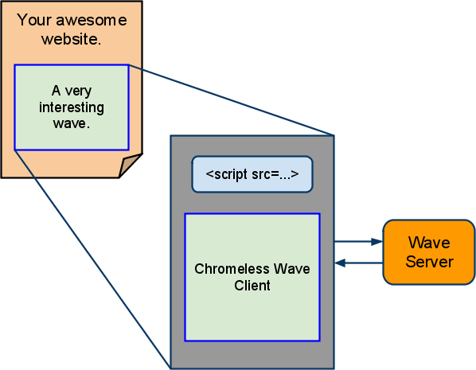
Embedding

Slide 6
Example Embed Code
<head>
<meta
http-equiv="content-type"
content="text/html; charset=utf-8"/>
<title>Google Wave Embed API Example: Simple Wave</title>
<script
src="http://wave-api.appspot.com/public/embed.js"
type="text/javascript"></script>
<script type="text/javascript">
function initialize() {
var wavePanel = new WavePanel(
'http://wave.google.com/a/wavesandbox.com/');
wavePanel.loadWave('wavesandbox.com!w+waveID');
wavePanel.init(document.getElementById('waveframe'));
}
</script>
</head>
<body onload="initialize()">
<div
id="waveframe"
style="width: 500px; height: 100%">
</div>
</body>

Slide 7
Extensions
What the users sees

Slide 8
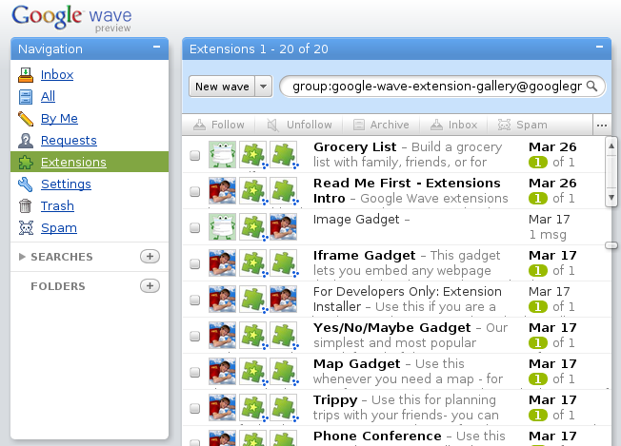
Extensions

Slide 9
Example Extension Manifest
<extension
name="Map Gadget"
thumbnailUrl="http://googl...et.png"
description="Collabor...ps.">
<author name="Google"/>
<menuHook
location="toolbar" text="Add Map Gadget"
iconUrl="https://wa...png">
<insertGadget url="http://...mappy.xml"/>
</menuHook>
</extension>
You may either hook newwavemenu or menuHook

Slide 10
Extension Hooks
Insert Gadget
Create a new wave
Annotate Selection
Add Participants

Slide 11
Gadgets

Slide 12
Gadget Features
Real-time updates.
Participant support.
State management with revision history.
Playback.

Slide 13
Adding a Gadget
Debug → Extensions → Add Gadget

Slide 14
Robots

Slide 15
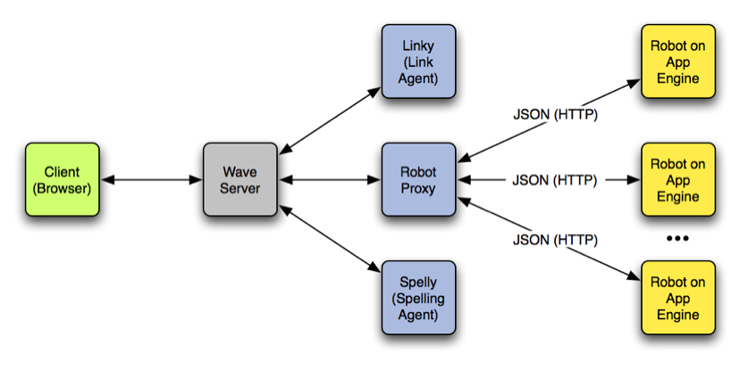
Architecture

Slide 16
Status
Run on Google App Engine
Have full access to wave
Respond to events on a wave
Java and Python APIs on Google App Engine

Slide 17
Google Wave Data API
No robot required

Slide 18
Status
Can manipulate waves as a user
Does not respond to events on a wave
JSON-RPC

Slide 19
The End
Questions?

